Slide 1
Robot arm learns how to make a bank shot
By Zeest Fatima

Slide 2
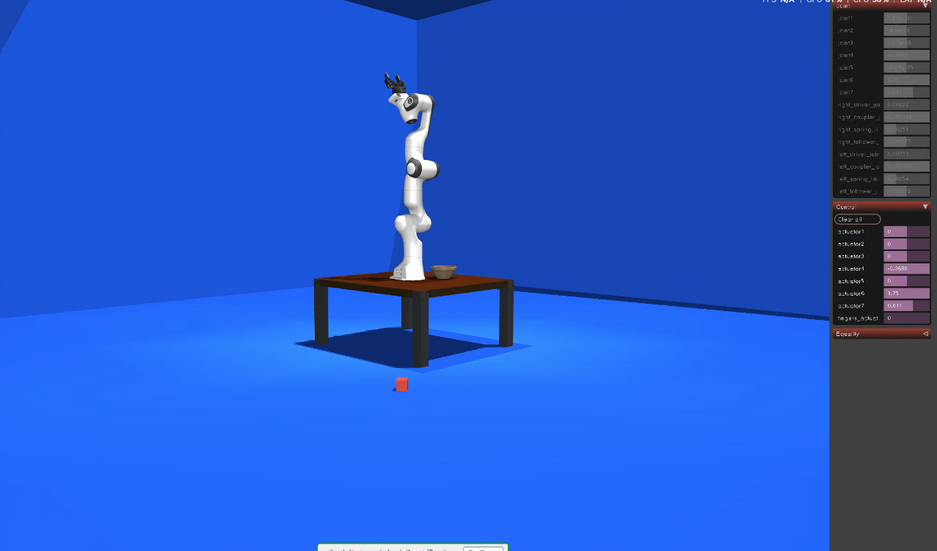
Initial Conditions
Robot arm sits on a table in the middle of a square-shaped room.
Room has dimensions 6m x 6m.
Robot starts with ball gripped in hand.
Walls all around are bounceable, including floor, roof and table .

Slide 3
Workflow Summary
Using PPO, robot learns to bounce a ball against any wall and land it on the floor, without hitting the table, floors or roof first.
Good PPO checkpoints are then used to collect trajectories/ episodes where the task was completed successfully.
A KNN regression model is used to map release parameters (i.e ball position, linear velocity and angular velocity at release) to final landing position on floor.
Pre-train a supervised imitation learning model using PPO trajectories to map actuator commands (7 joints + 1 gripper) to ball position, velocity and angular velocity at release.
Train a TD3 model online using the pre-trained model.

Slide 4
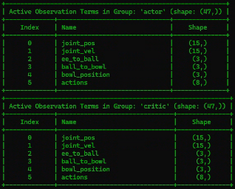
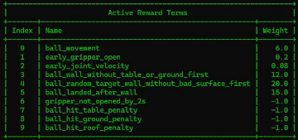
PPO Training
Task: ball is released from gripper -> hits wall -> hits floor. It must not hit floor, table or roof before wall.
Rewards: Sparse

Slide 5
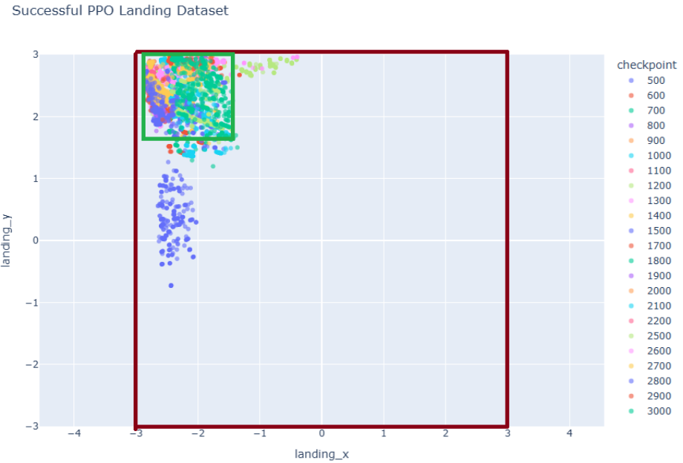
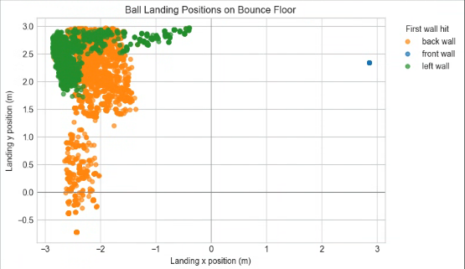
PPO Data Collection
Training ran until 5000 checkpoints, and checkpoints saved at intervals of 500.
Best checkpoints seem to be between 500 and 3000. Collect 1000 successful trajectories from 23 best checkpoints. In total collect 23000 “good” + 460 “bad” trajectories.
Floor landing positions of “good” trajectories by checkpoint.
Floor landing positions compared to which wall the ball first hit.

Slide 6
PPO Data Collection
Metrics Collected Summary:
Per-step data: action, reward, achieved goal, desired goal, ball position + velocity, episode ID + step, timestep
Timing: wall contact step, landing step, ball release step
Release state: gripper position at release + ball position, velocity and angular velocity (spin) at release
Landing + wall contacts: wall contact position, final landing position, Boolean: hit wall first, landed after wall, hit ground OR table OR roof first, is it success
Checkpoint meta data: good eps + bad eps per checkpoint, checkpoint ID etc., action + goal + observation dimensions

Slide 7
Ball Release State
Ball release metrics are defined by the timestamp at which: 1) abs (ball height – robot palm height) > 0.02m AND 2) abs (ball linear velocity – robot palm velocity) > 0.05 m/s
At the first timestep where release became true, the collector saved:
Release step
Ball position
Ball velocity
Ball angular velocity
Gripper palm position at release

Slide 8
K-Nearest Neighbors Regression
Task: Mapping release parameters (the ball’s position, velocity and spin) to the final landing point on the floor, using data from PPO.
Tested 3 regression models:
Nearest Neighbor regression:
Given a target landing point, it finds the one PPO trajectory whose landing point is closest to the target. Then it reuses that trajectory’s release state.
Weighted KNN:
This finds several nearby PPO landings, not just one. Then it averages their release states, with closer examples getting more weight.
Local Ridge Regression
For each target landing point, it still finds nearby PPO examples. But instead of averaging their release states, it fits a small local linear model.

Slide 9
KNN Evaluation
Tests whether release state produces desired landing position when simulated.
In the evaluation, the robot arm does not throw the ball, instead the evaluator directly sets the ball’s position, linear velocity and angular velocity (spin) to the predicted release state, then steps MuJoCo simulation forward with neutral gripper actions.
Evaluate KNN release planner and simulation physics but not actuator control.
Finally, we plot target x and y coordinates (from PPO) against actual landing coordinates (from MuJuCo simulation).

Slide 10
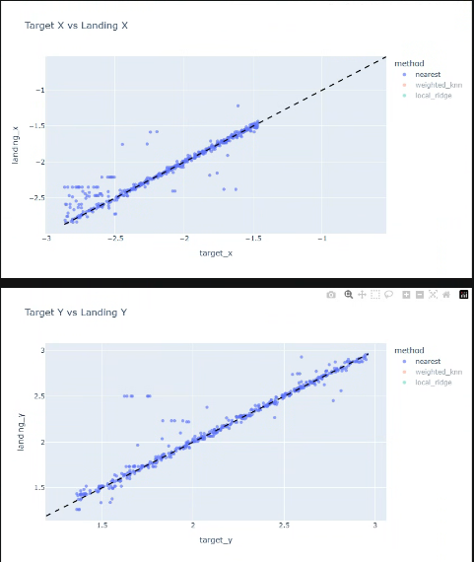
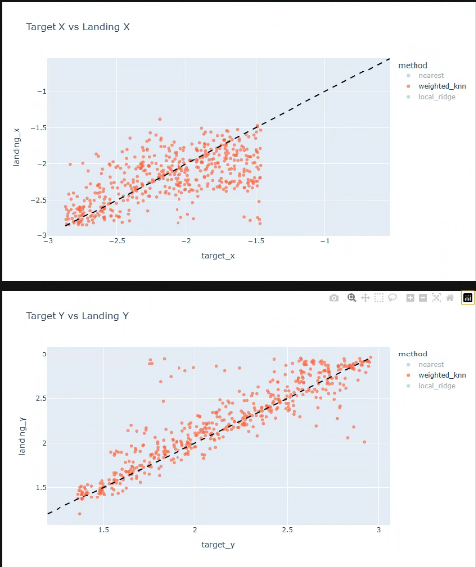
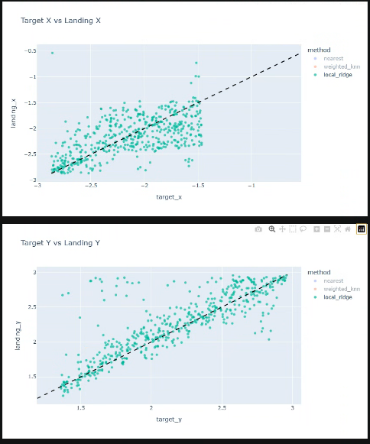
KNN Model Performance Comparison
Simple K-Nearest Neighbors vs Weighted KNN vs Local Ridge regression,
80% success rate 13% success rate 13% success rate

Slide 11
Offline Supervised Imitation Learning Model
Offline pre-training for TD3
Task: Learns to map actions of 8 actuator joints (including gripper) to ball’s release state (release position, velocity, spin).
Trained on all 23000 checkpoint episodes (only successful ones).
Uses ideas from a paper on max-achievement/ release-match scoring. Optimize weighted action prediction error, so we use weighted MSE imitation loss, rather than cumulative reward maximization.
Predicted action = actor(observation, desired release state)
Loss = MSE(Predicted action , PPO action)

Slide 12
Offline Supervised Imitation Learning Model
Learns which PPO timesteps matter more. Used the following dense rewards:
release position closeness score: exp(- abs(ball pos – target release pos) / pos scale)
release velocity closeness score: exp(- abs(ball vel – target release vel) / vel scale)
release spin closeness
Release-match score: pos weight * pos score + vel weight * vel score
best score reached so far: for each eps, computes best release-match score up to current timestamp.
improvement in best score: computes how much best score improved at each timestep.
release timestep / near-release steps: treated small window around release with higher weight
Final weight: CLIP (0.10 + 1.5 * best score + 4.0 * improvement + 1.0 * near release, 0.05 , 8.0)

Slide 13
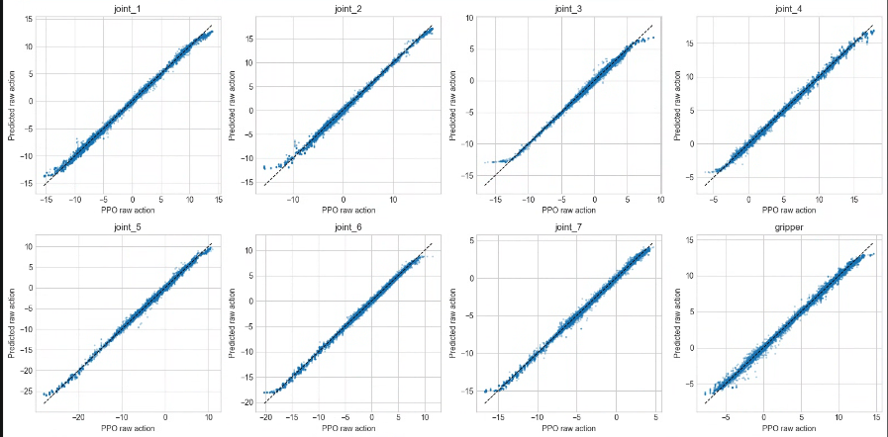
Offline Supervised Imitation Learning Model
Trained on all of 23000 episodes collected from PPO
The actor predicts/ outputs normalized actions. We denormalize and compare the action’s joint movement predictions to PPO actions, and get the following plots.
Seems to be imitating PPO trajectories well.

Slide 14
TD3 training
Task: improve actuator policy beyond offline behavior cloning.
Replay split into 3 buffers:
Offline seed replay
Sample ratio: 20%
Filled with successful PPO data before online training starts
Target goal is PPO recorded release state (vel + pos + spin at release)
Online replay
Sample ratio: 50%
Actor is given a sampled desired release state (from PPO release dataset). You also specify exploration noise.
Reward is max-achievement dense reward
HER replay
Sample ratio: 30%
At the end of each online episode, notebook looks at best release state the robot achieved. Then it copies that into HER replay and relabels goal = best achieved release state
Dense rewards set up identical to the pre-trained model.
Critic trained from Bellman targets and actor trained from critic estimates + pre-trained behavior cloning model estimates.

